Slide 1
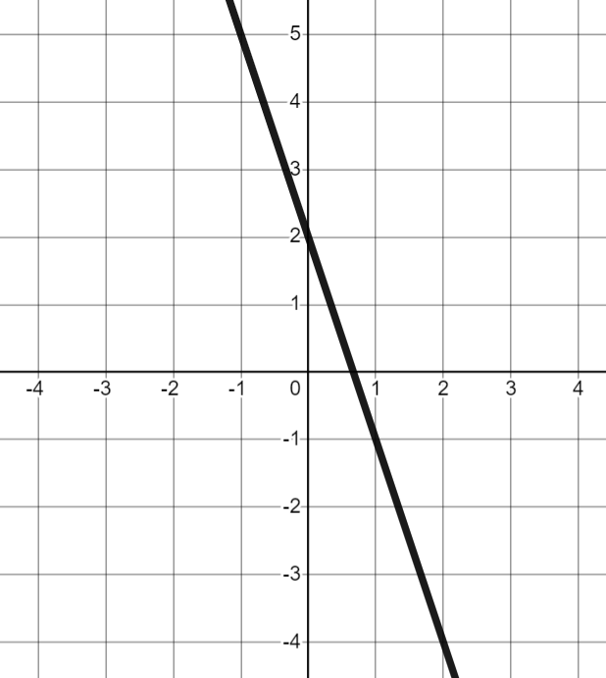
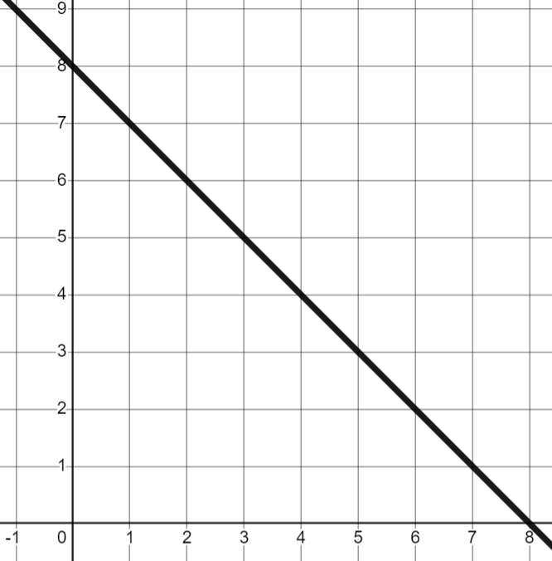
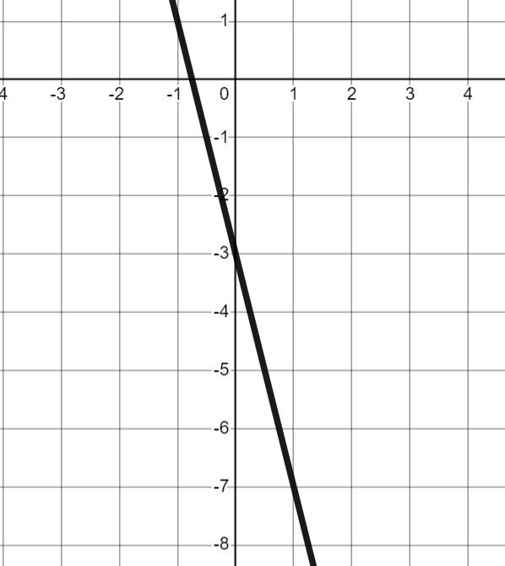
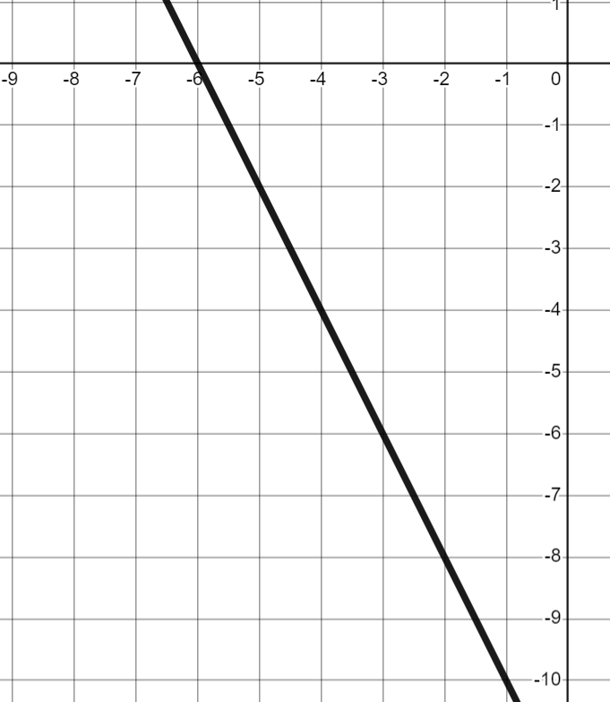
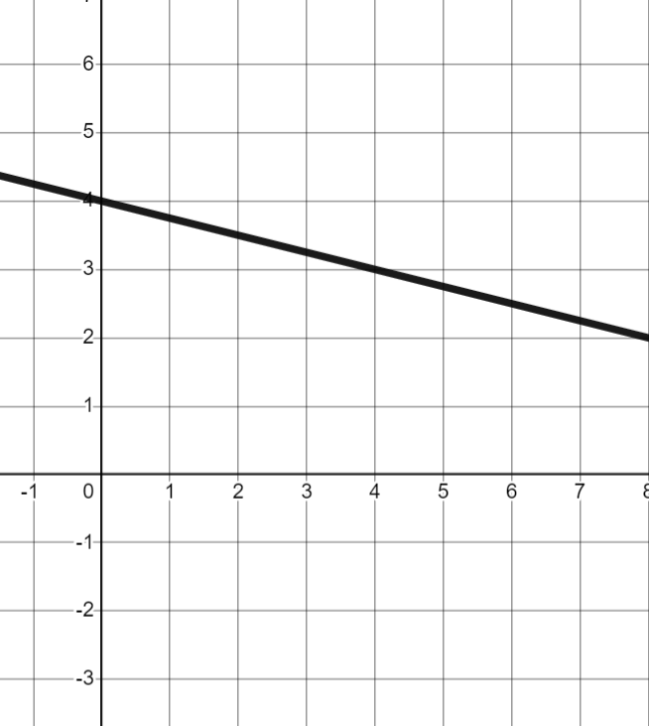
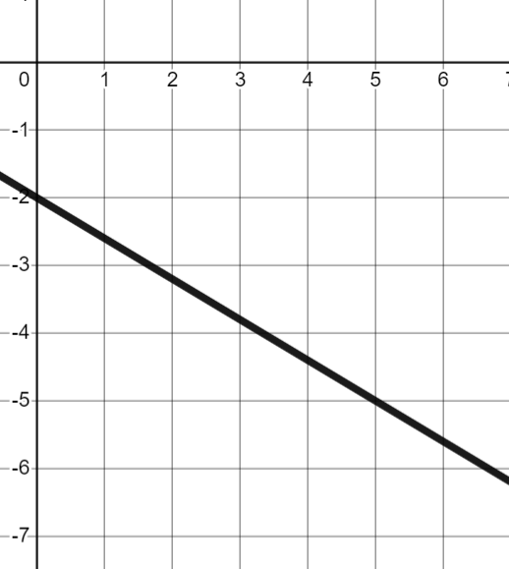
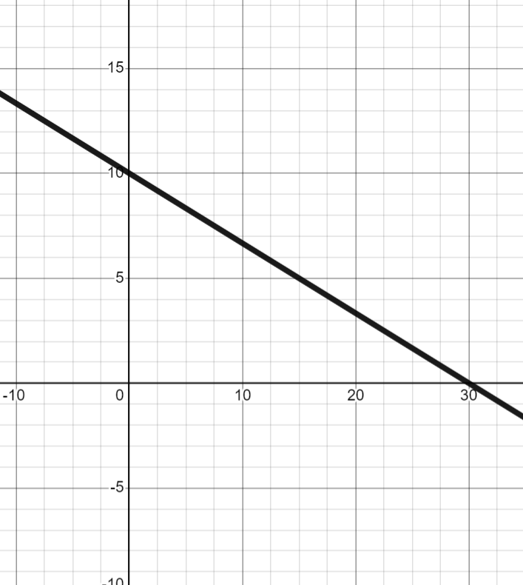
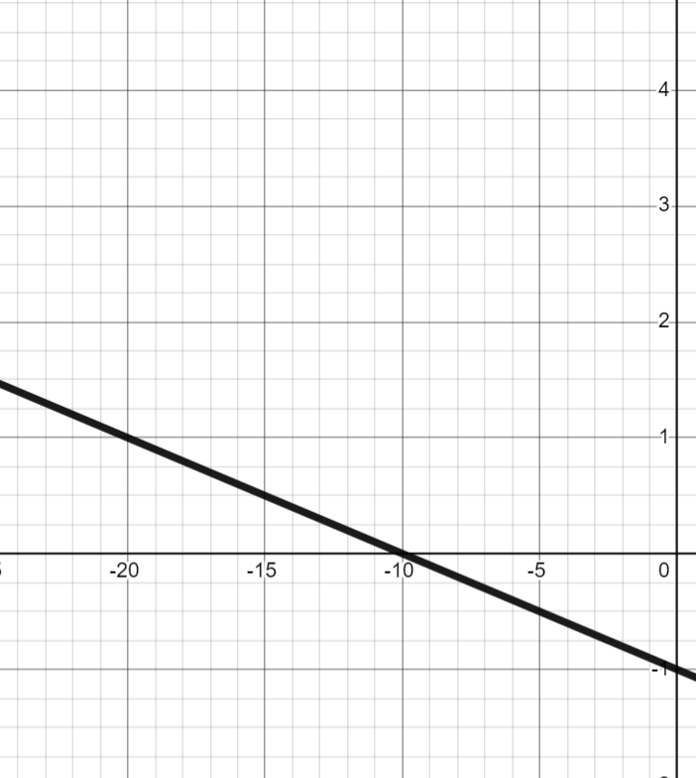



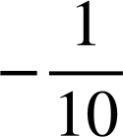
Negative rate of change from a graph
Task A: Calculating negative gradients from graphs
1) Find the gradient of each line.
a) | b) | c) | d)
−3
−1
−4
−2
e) | f) | g) | h)
4 | −1
1
5 | −3
1
30 | −10
1
10 | −1
1

Slide 2
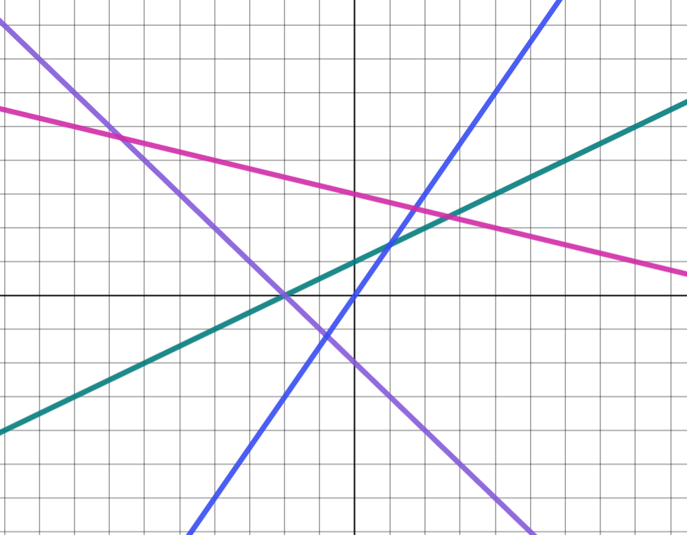

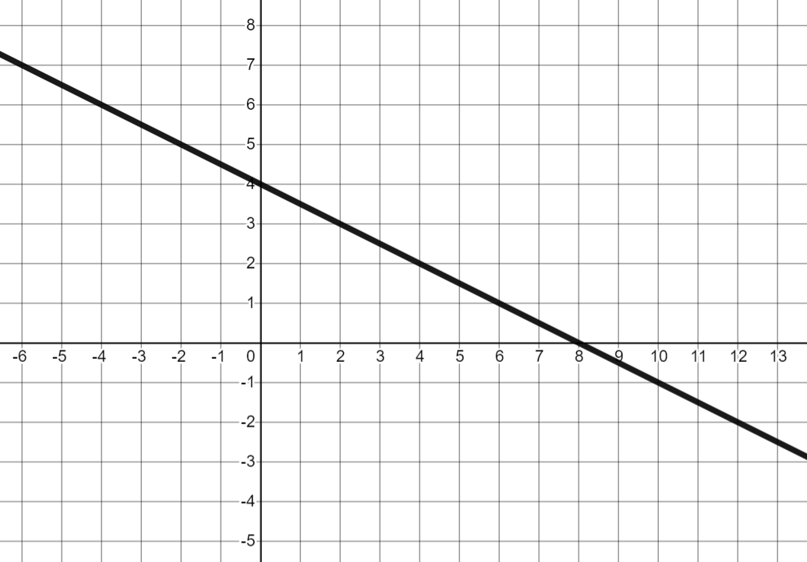
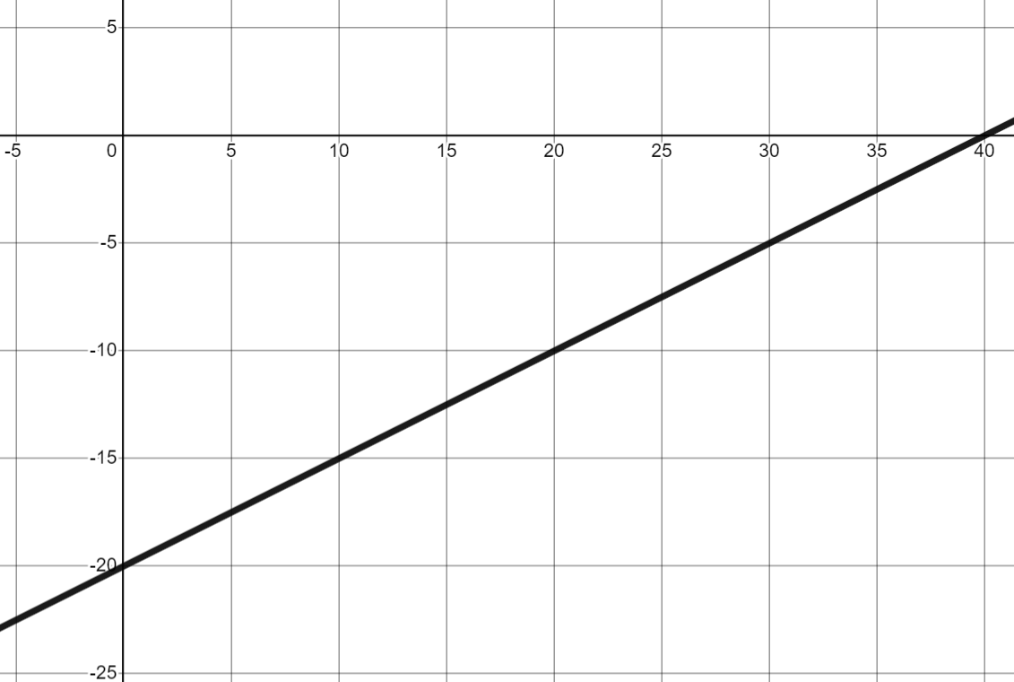
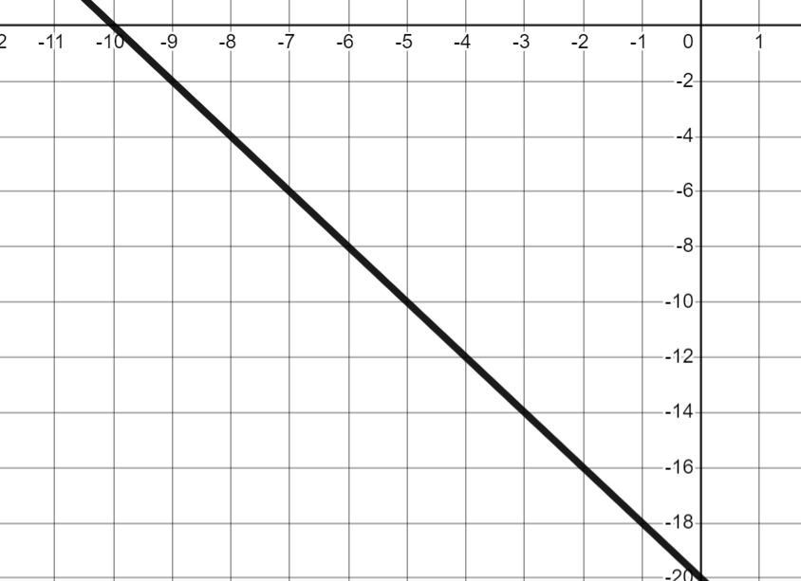

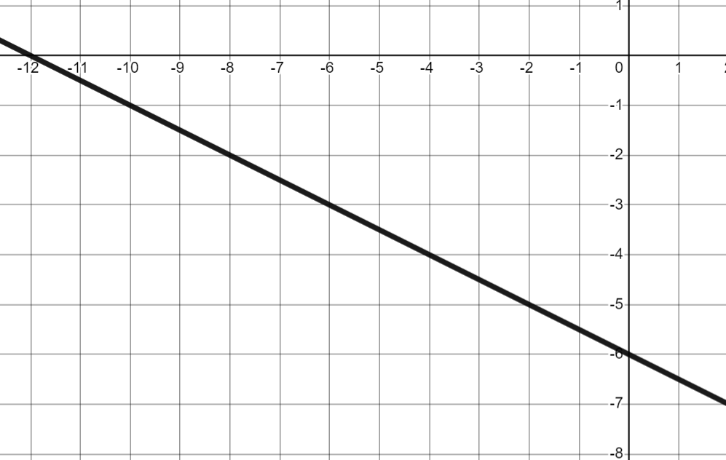
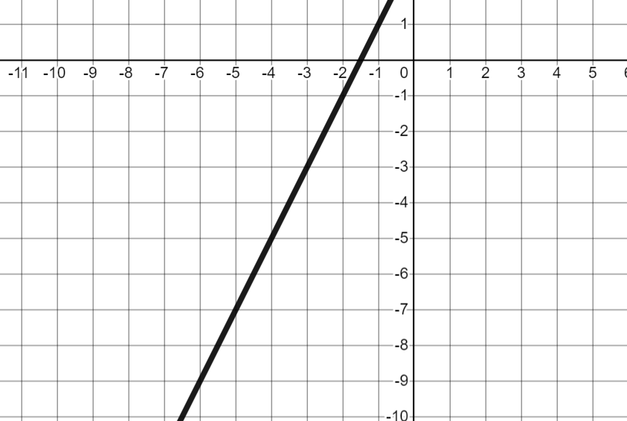
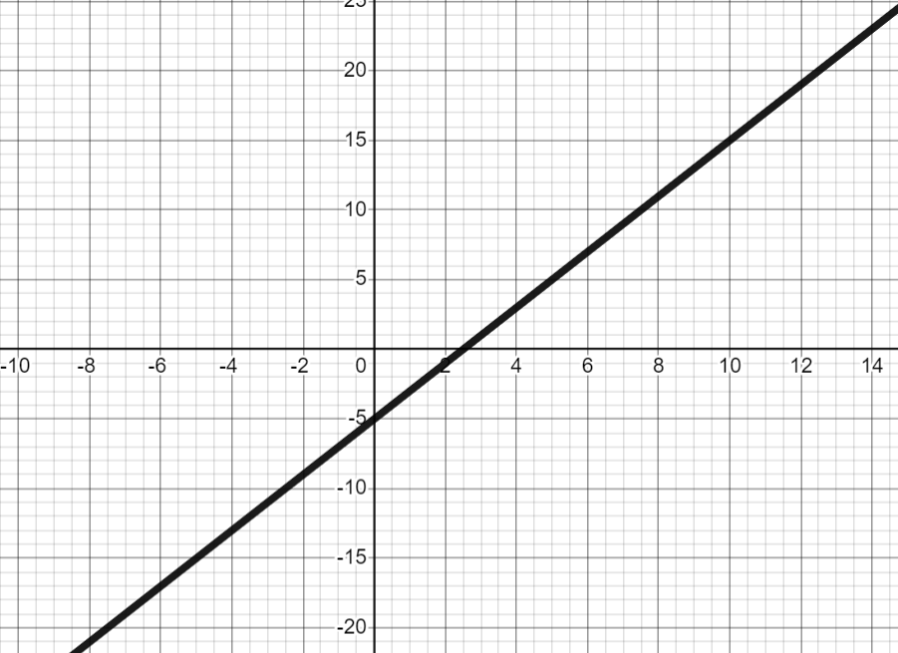

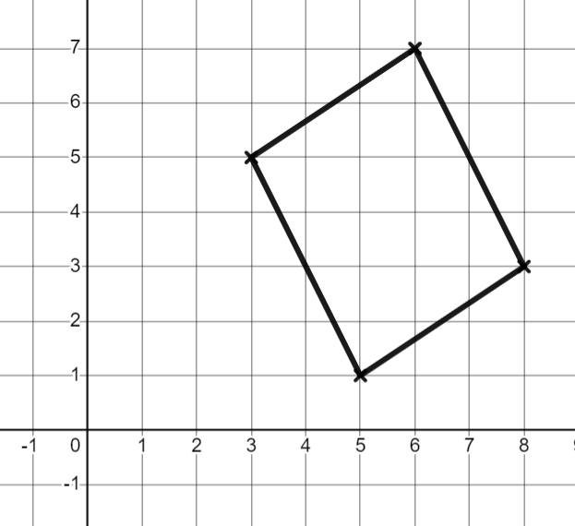


Negative rate of change from a graph
Task B: Calculating gradient from any graph
1) Four lines have been drawn on a set of axes with unknown scale. Match each line to its gradient.
D
B (green line)
gradient = 1
gradient = 3
gradient = −2
gradient =
C
A (blue line)
D (purple line)
B
C (pink line)
A
2) Which lines are parallel?
Calculate the gradients and match any parallel lines.
A
B
C
A and D are parallel
E and F are parallel
Gradient =
Gradient =
Gradient = −2
D
E
F
Gradient =
Gradient = 2
Gradient = 2
3) Andeep is trying to prove this shape is a parallelogram
Finish off his working out.
Opposite sides in a parallelogram are parallel. Therefore they must have the same gradient.
+2
+3
+2
The left and right sides are parallel…
Andeep
+3
Change in x | Change in y
3 | 2
1
The top and bottom sides have the same gradient of so they are parallel.
Mathematics in Education and Industry
v2.2

